Slide 1
SGC Open Chemistry Networks
The SGC’s aim: 500 probes in 5 years.
In the last 10 years the SGC has delivered 200 probes. Those came mostly from pharma groups, rather than from the wider scientific community.
2) The SGC will achieve this more quickly if we can stimulate a major increase in open synthetic chemistry from the broader scientific community.
Distributed chemistry on a planetary scale.
Molecules that are not commercially available
3) The SGC is offering its biology and associated expertise to evaluate molecules
in exchange for synthetic chemistry
Work together on science, papers, raising funds.

Slide 2
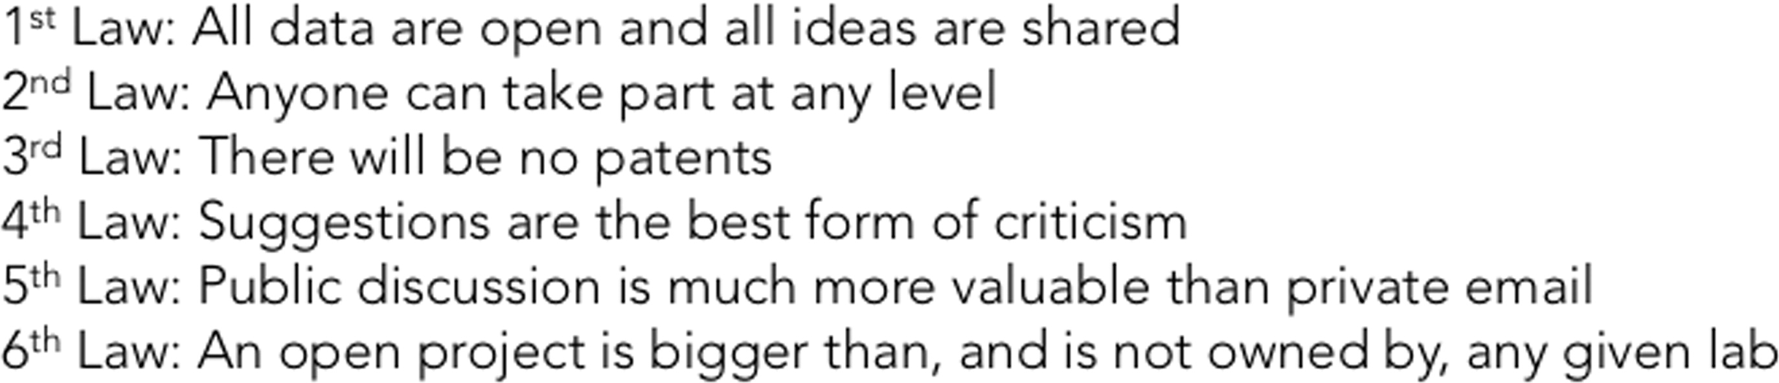
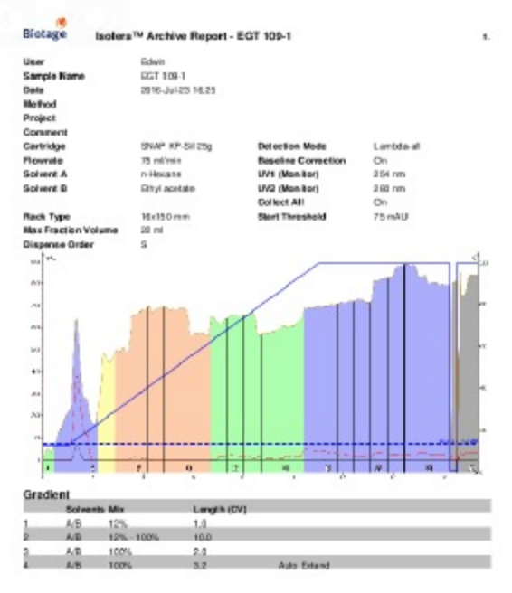
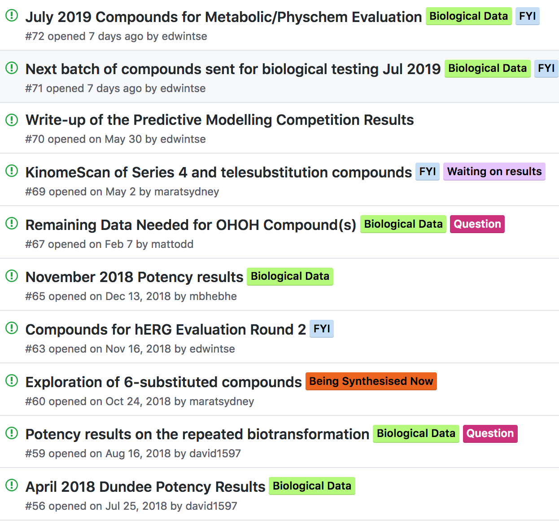
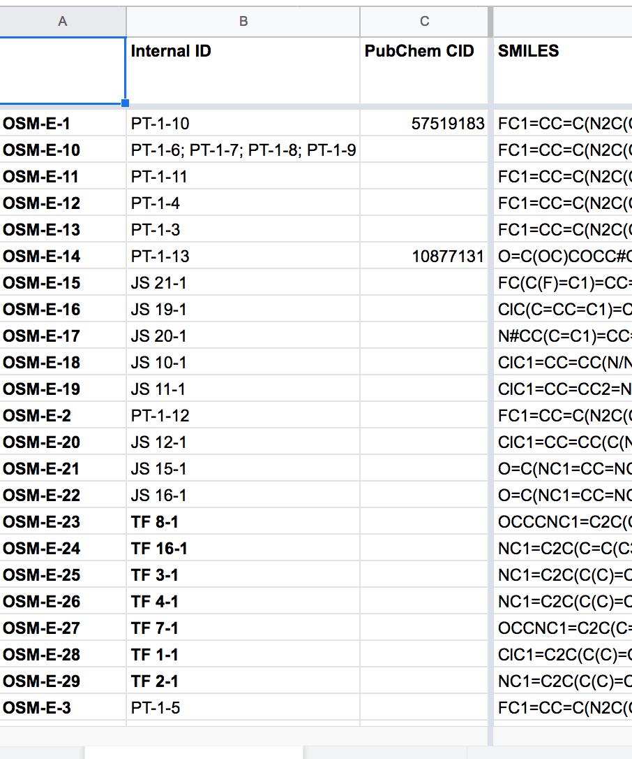
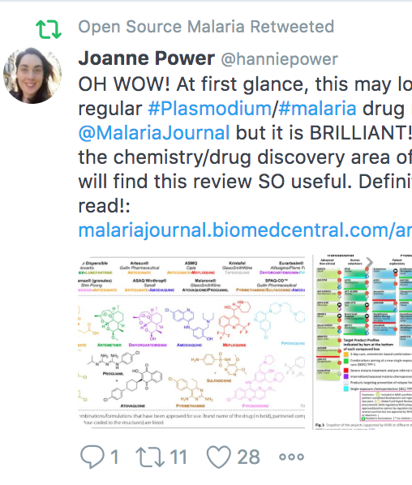
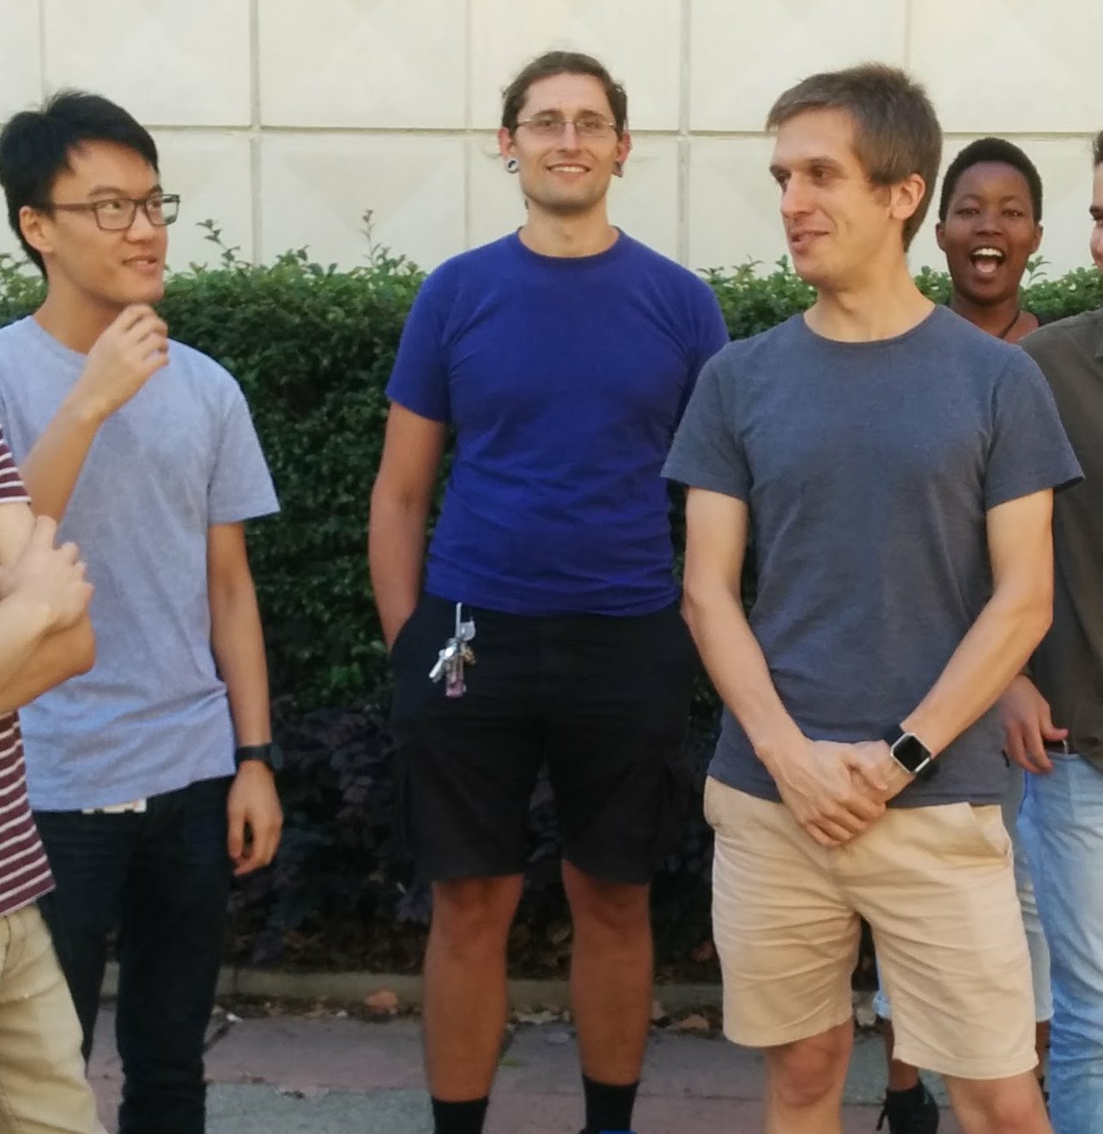
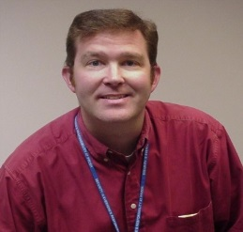
Open Means Open Throughout
Malaria: ACS Cent. Sci. 2016, 2, 687; J. Med. Chem. 2020, 63, 11585; J. Org. Chem. 2020, 85, 13438. TB: J. Med. Chem. 2018, 61, 11327. Antifungals: PLoS NTD 2018, 12(4): e0006437. Platform: Chem. Sci. 2015, 6, 1614; Parasitology 2014, 141, 148. Laws: ChemMedChem, 2019, 14, 1804.
Components
Contributions
Laboratory Notebooks
Public To Do Lists/Discussion
Open Data
Community
Students
Pharma

Slide 3
Multiple Components Learned from Projects over 15 Years
Parent SGC website
Not community curated
Lists targets, status, rationale
RULES and LICENCE
Links out to project hubs
Raw Data
Managed by individuals
Electronic Lab Notebooks
Essential criteria:
1) Openness/licence; 2) Completeness
3) Permanence; 4) Machine readability
Living Paper
Hosted by a journal
New version released upon milestones
Cleanest version of Project Status
Maintains authorship list
Incentivizes
(We’ve a journal interested)
Probe Hubs
Managed by 1) science leads; 2) community; 3) industry mentor;
4) Student Champion
Includes: project status suitable for outsiders, To Do Lists, discussion forum, file store etc
Monthly Science Meetings
Each project.
Open to all.
Zoom, recorded.
Placed on Youtube
Linked to Action Items on Hub
Publicity/Outreach
Promoting project
Route to donations
Logo:
“Proudly Partnering with the SGC”
(click here to find out what this means)
→ Page of terms
SGC Chemistry Networks Social Media
Used by SGC admin, probe leads, contributors
Disseminates new results
Sends out community requests
Advertises through fun posts of contributors

Slide 4
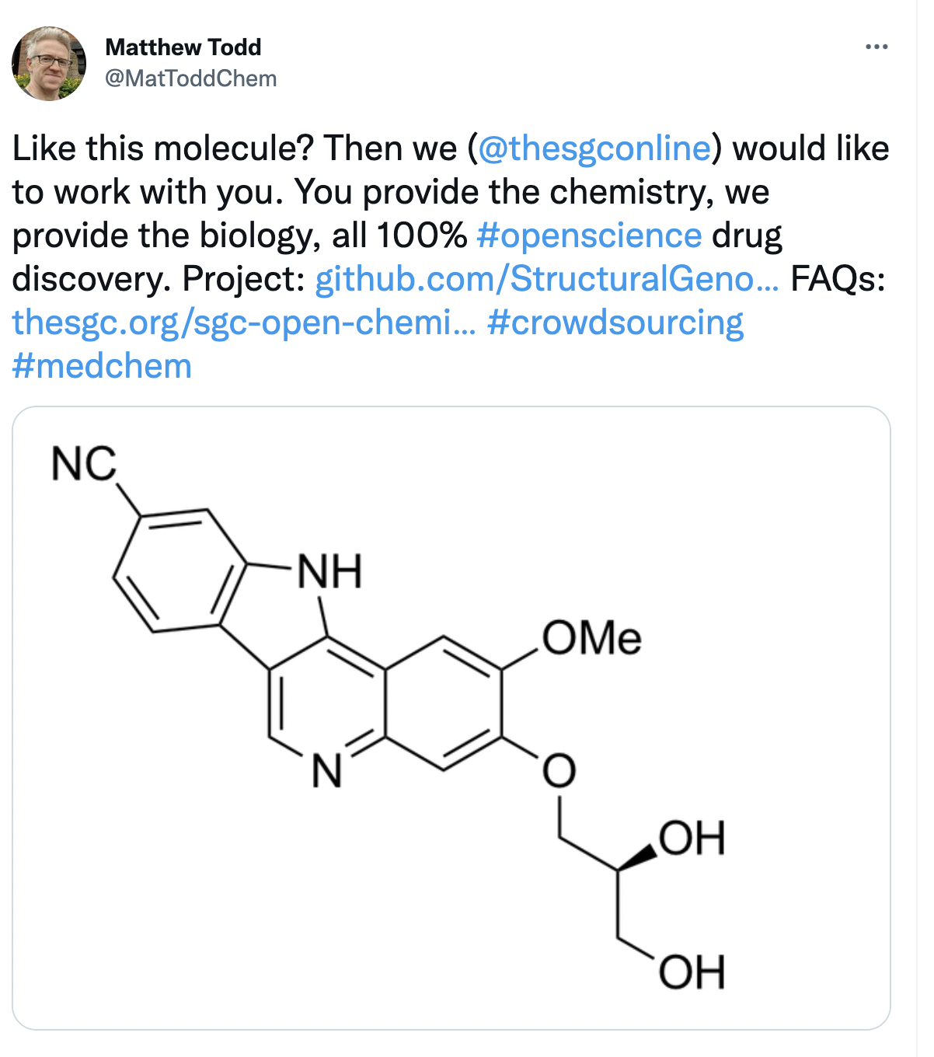
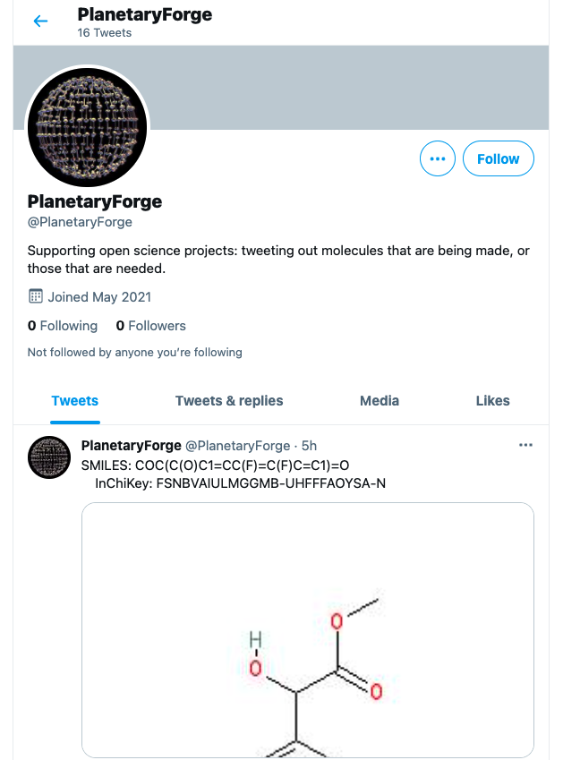
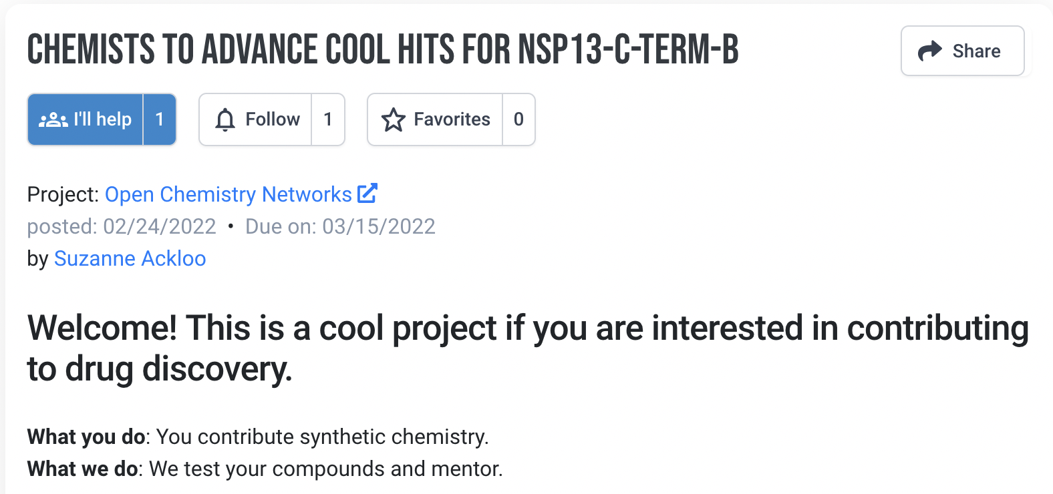
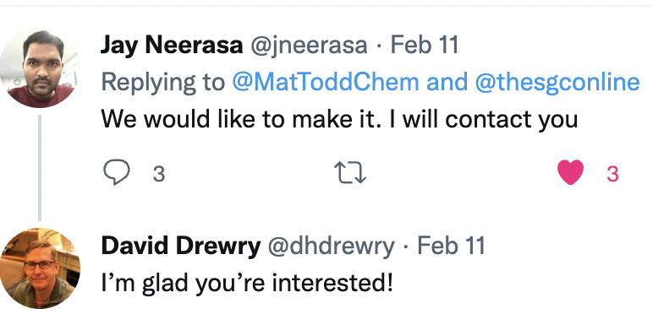
Going to Need a Lot of Advertising

Slide 5
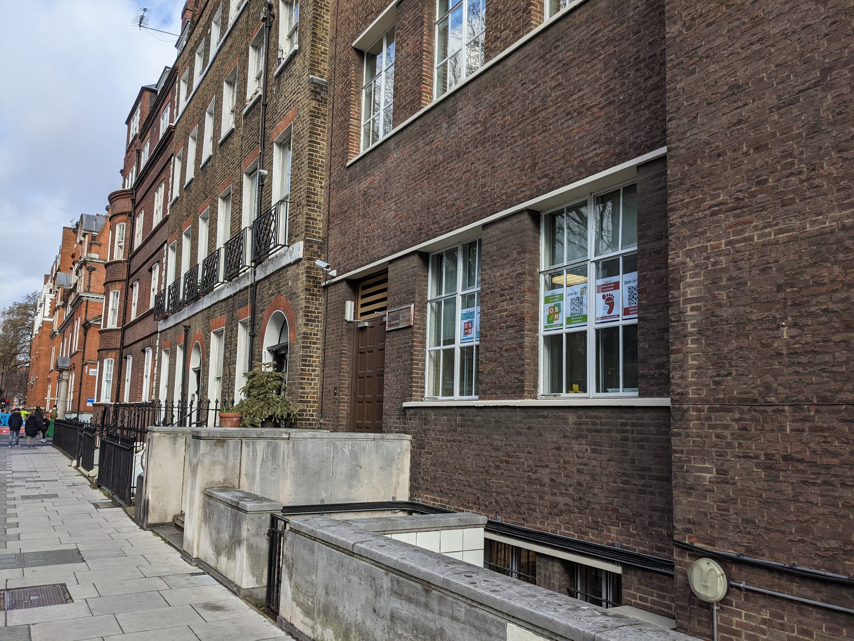

Going to Need a Lot of Advertising

Slide 6
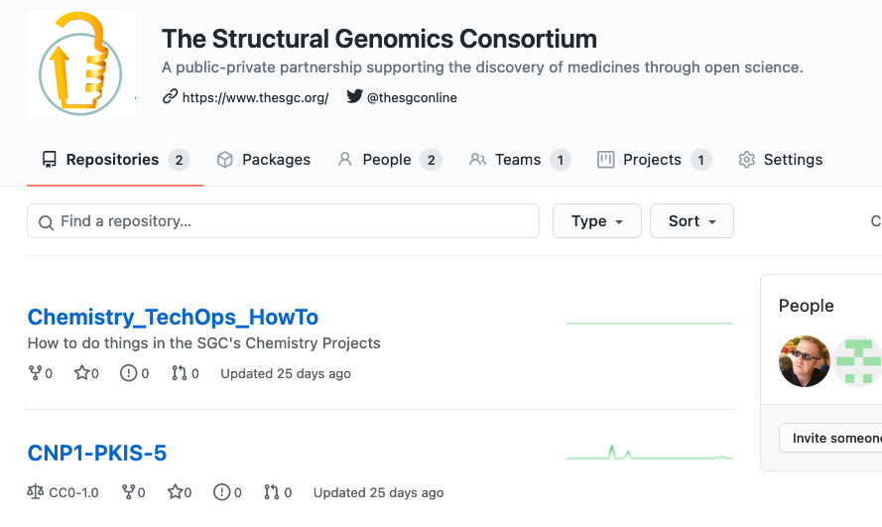
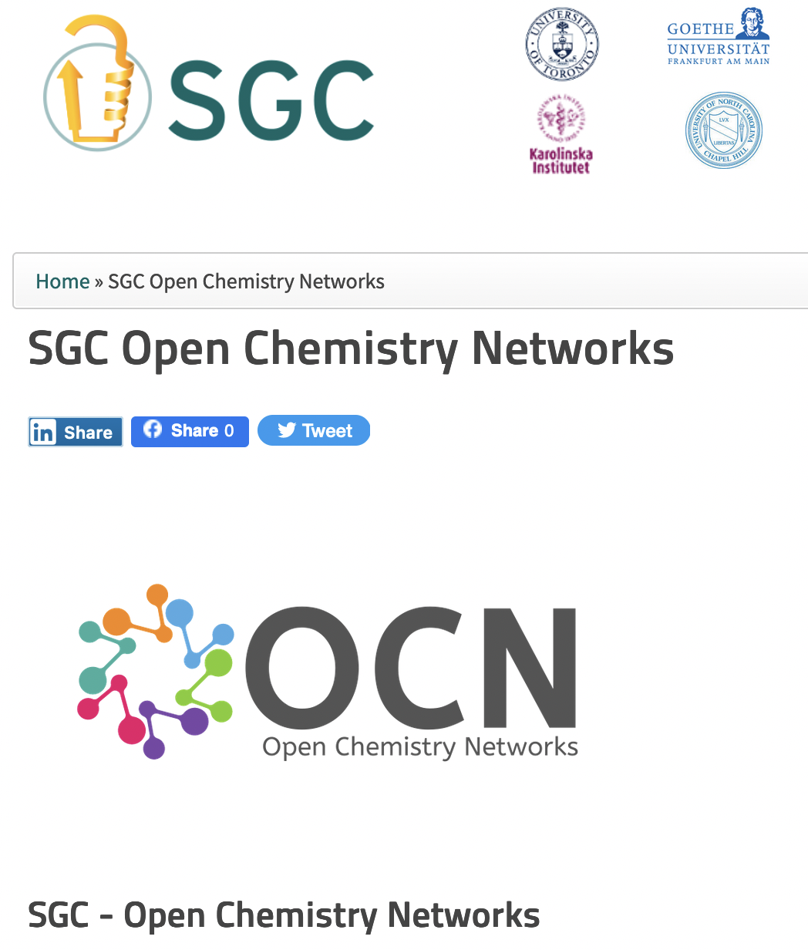
Open Chemistry Networks Landing Pages
SGC Home
Landing Page
FAQs
T&Cs
Github
Scientific hub, collaborative interactions
https://github.com/StructuralGenomicsConsortium

Slide 7
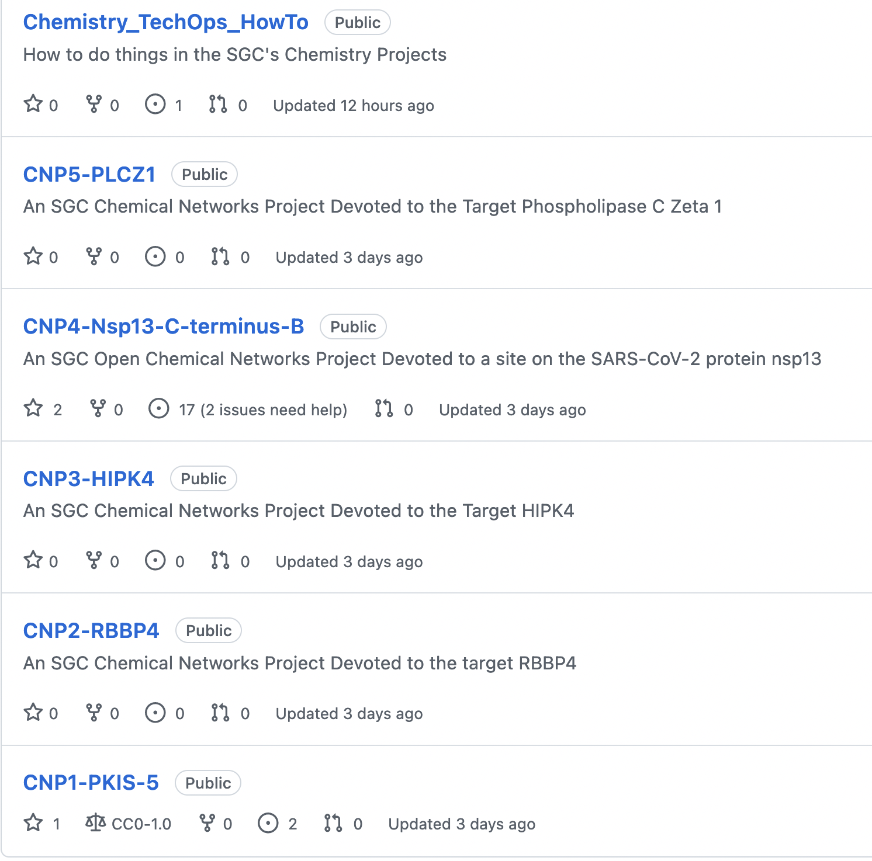
Each Target has its own “Repository”
https://github.com/StructuralGenomicsConsortium/

Slide 8
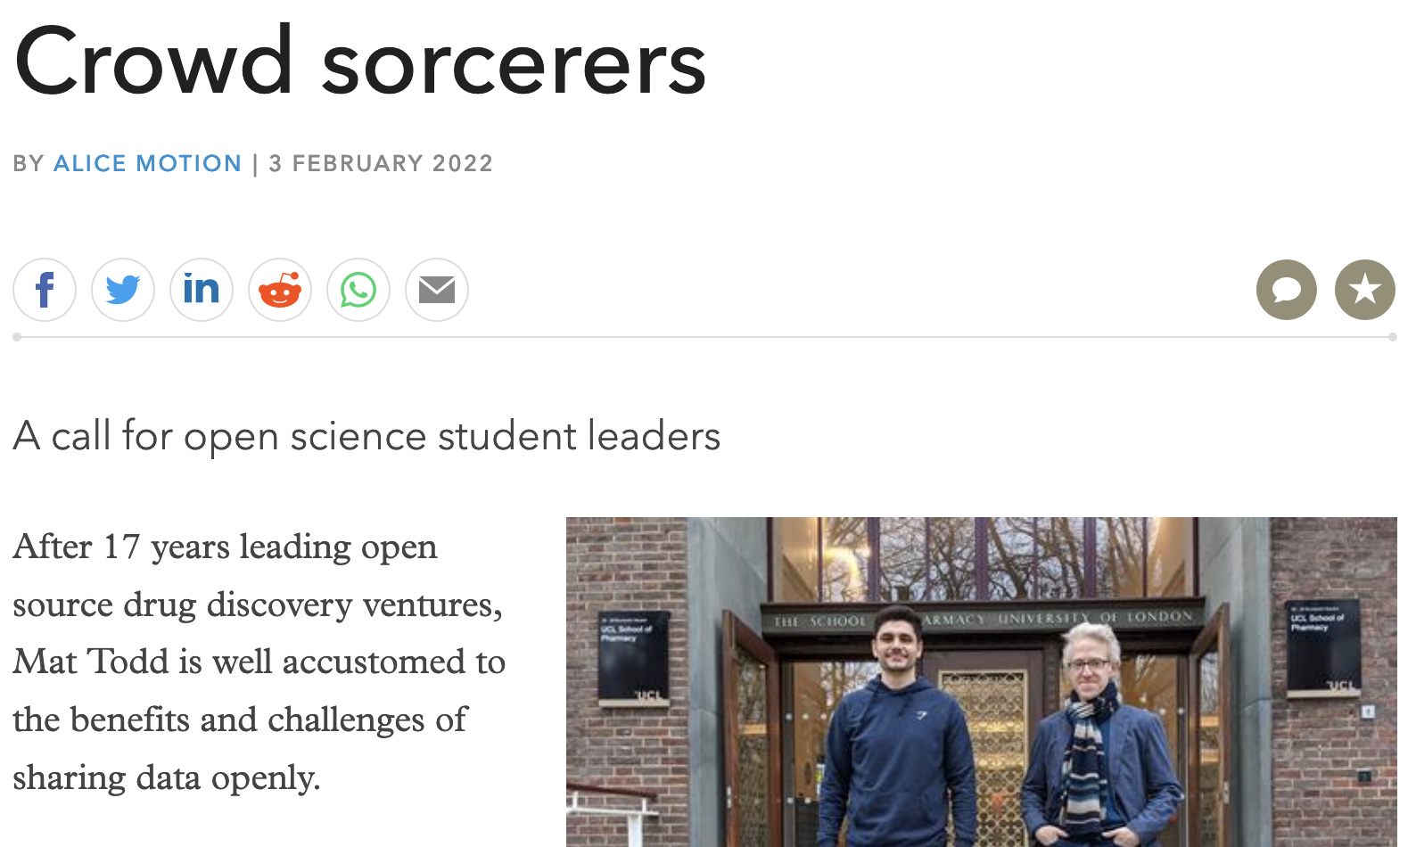
Sir James Murray Student Champions
Graduate-level
Doesn’t need to be in lab
Project manager role
Please forward to potentials
https://www.chemistryworld.com/opinion/a-call-for-open-science-student-leaders/4015107.article
https://github.com/StructuralGenomicsConsortium/Chemistry_TechOps_HowTo/wiki/Sir-James-Murray-Student-Champions

Slide 9
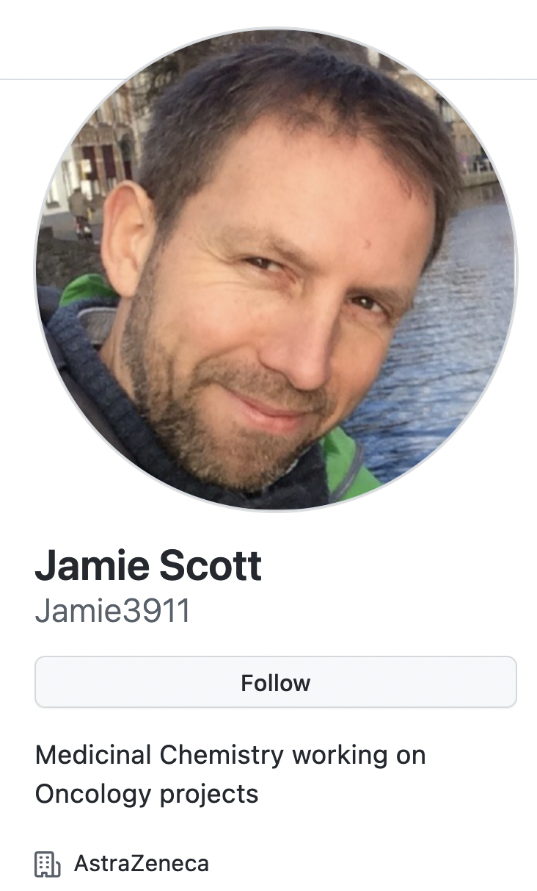
Pharma Champions
One project
3 hours per month
High level strategy role
Please forward to potentials
Feb 2022 recruits:
Jamie Scott, AZ
James Day, Astex
https://github.com/StructuralGenomicsConsortium/Chemistry_TechOps_HowTo/wiki/Pharma-Industry-Champions

Slide 10
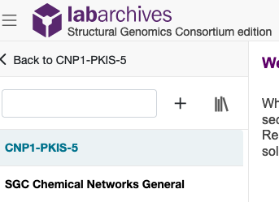
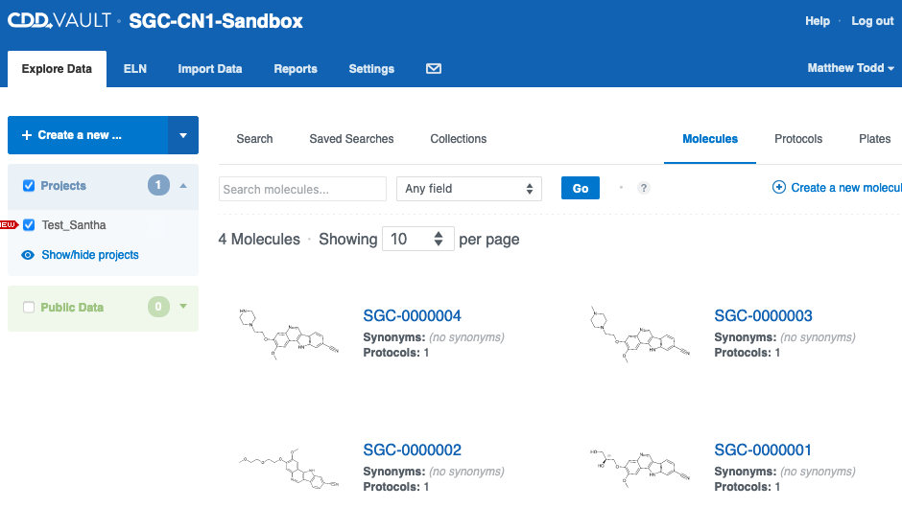
Resources
Electronic Lab Notebook
Everything publicly viewable
Intuitive interface
SGC can invite people to sign up, to contribute
Currently freely provided
Possibly CDD Vault for Molecule Data
Everything not publicly viewable by default
(so probably won’t work)
SGC can invite people to sign up, to contribute
Currently freely provided

Slide 11
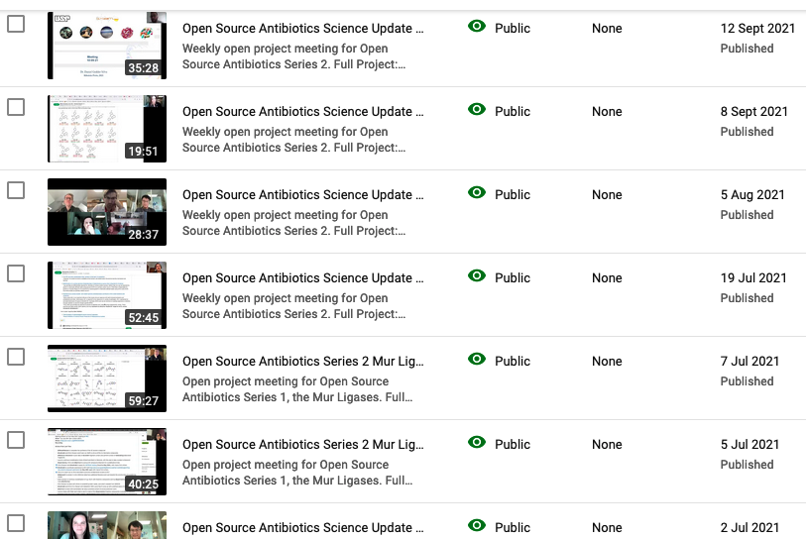
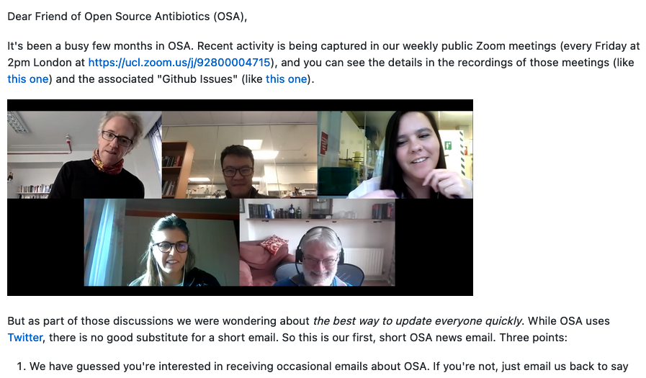
Open Online Strategy Meetings Starting
https://github.com/opensourceantibiotics/Series-2-Diarylimidazoles/issues/34

Slide 12

Open Chemistry Networks (OCN) Summary Update
DONE
Lab notebook set up for contributors (Labarchives, SGC-branded).
Main websites up (e.g., https://www.thesgc.org/sgc-open-chemistry-networks) with complete T&Cs.
Central hub up (https://github.com/StructuralGenomicsConsortium) with first 5 projects. Some busy, some waiting to get started.
Feature article published in Chemistry World (https://www.chemistryworld.com/opinion/a-call-for-open-science-student-leaders/4015107.article) about the Sir James Murray Student Champ role (https://github.com/mattodd/blog/issues/6).
Project 2 (RBBP4) recruited Pharma Champion (Jamie Scott, AZ) and Student Champion (Sumera Perveen, Toronto). First meeting coming.
Project 4 (Nsp13) recruited Pharma Champion (James Day, Astex) and Student Champion (Tom Knight, UCL). Weekly project meetings, first overview meeting March 28th.
First trial advert asking for synthesis got lots of attention; following up.
Discussion with Foldit (with Matthieu) about using OCN to source their CACHE suggestions.
Part of AViDD grant application to NIH for new antivirals.
NEED
More advertising! More social media activity!
More pharma champs, more student champs.
Project sites for Gates targets (Levon has joined. Everyone else?).
Compound Registration System – still not sure of best solution.

Slide 13
Current OCN Needs
PIs and lab researchers to get onto Github and use open infrastructure
Suggestions/nominations for Student and Pharma Champions
Want to run an EUbOPEN project?

